Slide 1

WELCOME

Slide 2

Team Members
Bivas Nandan Debnath
MD. Shirajus Salekin
Nazim Uddin Asif
ID:22201256
ID:22201268
ID:22201271

Slide 3
Introduction
A Hospital Management System is a software solution designed to streamline hospital operations like patient registration, appointment scheduling, medical recordkeeping, and billing. It enhances coordination between departments, improves patient care, reduces errors, minimizes paperwork, and provides real-time access to data. User-friendly and efficient, it simplifies hospital management for staff and ensures better healthcare delivery.

Slide 4
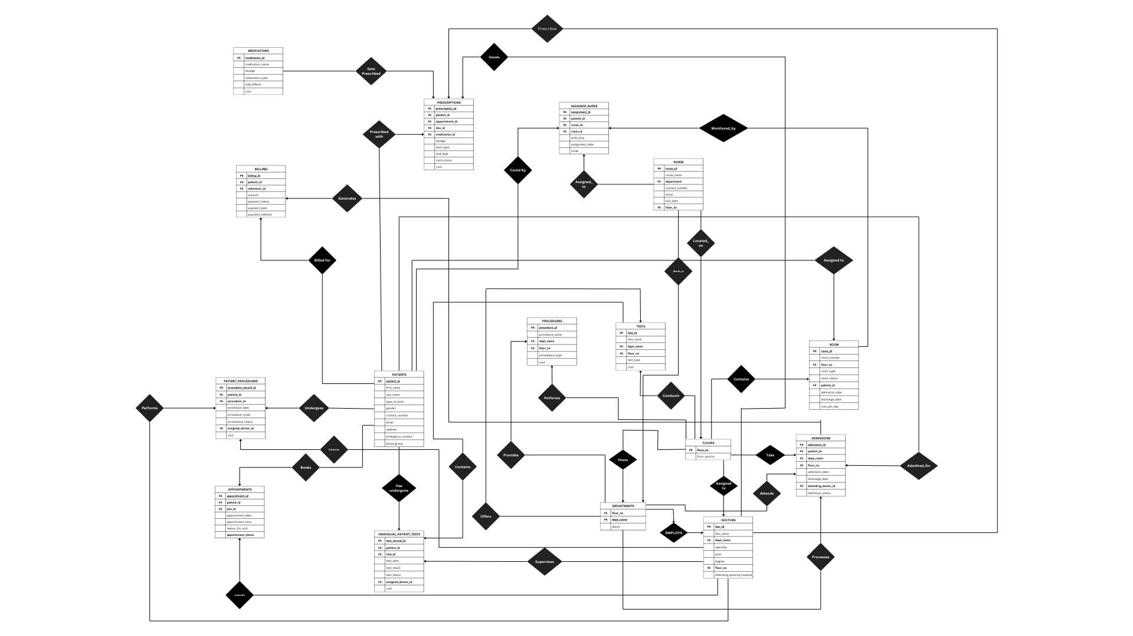
(ER) Diagram

Slide 5
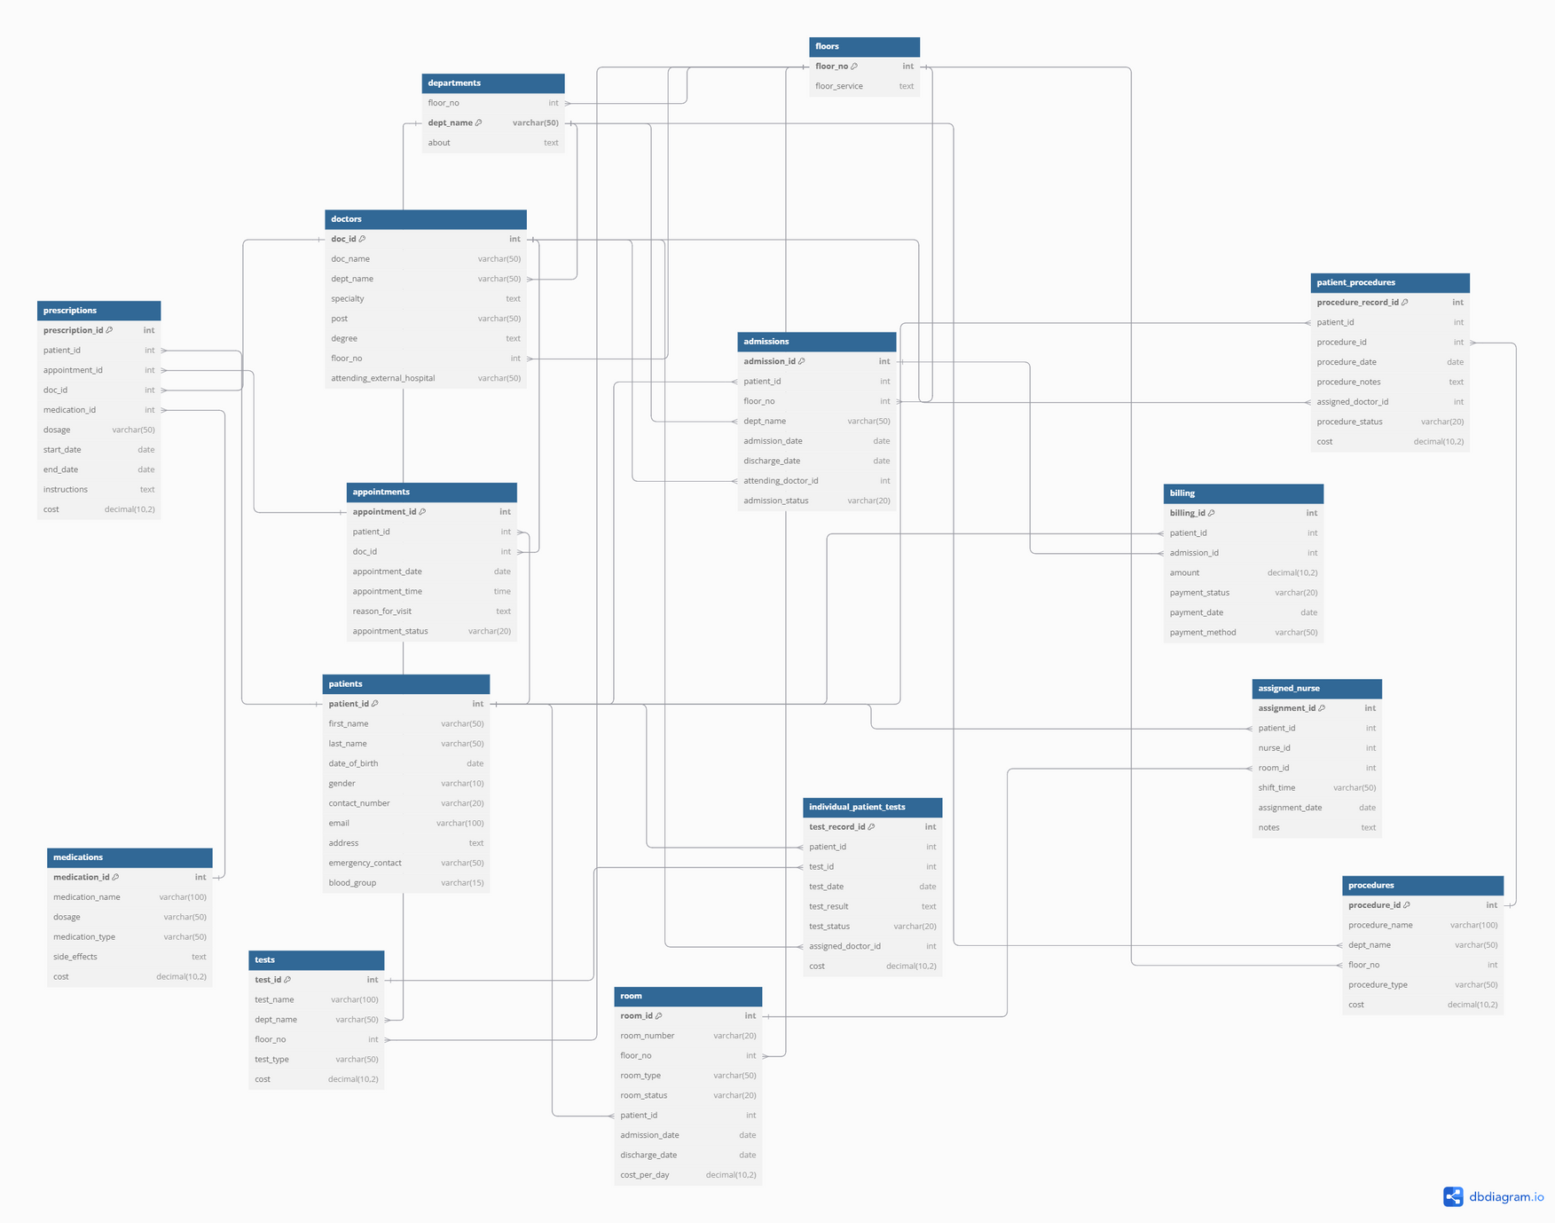

Schema Diagram

Slide 6
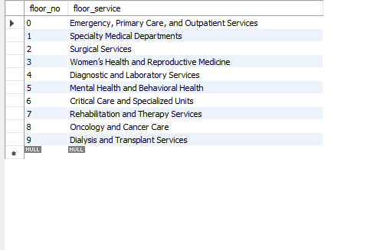
Simple Queries

Slide 7

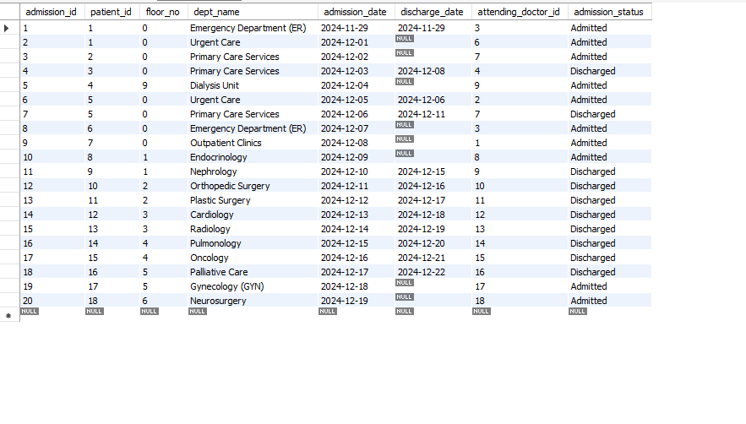
Simple Queries

Slide 8
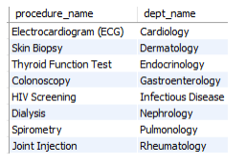
●
Retrieve the list of procedures conducted in departments located on the floor with the maximum number of departments
SELECT procedure_name, dept_name
FROM procedures
WHERE dept_name IN (SELECT dept_name FROM departments
WHERE floor_no = (SELECT floor_no FROM (SELECT floor_no, COUNT(*) AS dept_count FROM departments
GROUP BY floor_no) AS subquery
ORDER BY dept_count DESC
LIMIT 1));
Intermediate Queries / Sub
Queries

Slide 9
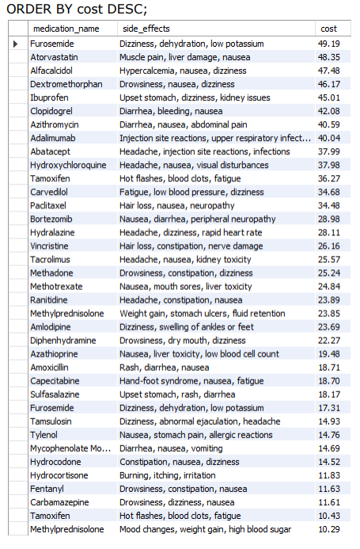
● List all medications with their side effects that cost less than $50:
SELECT medication_name, side_effects, cost
FROM medications
WHERE cost < 50
Intermediate Queries / Sub
Queries

Slide 10

THANK YOU!

Slide 11
Any Question?

